Slide 1
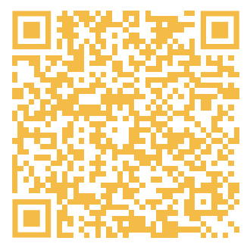
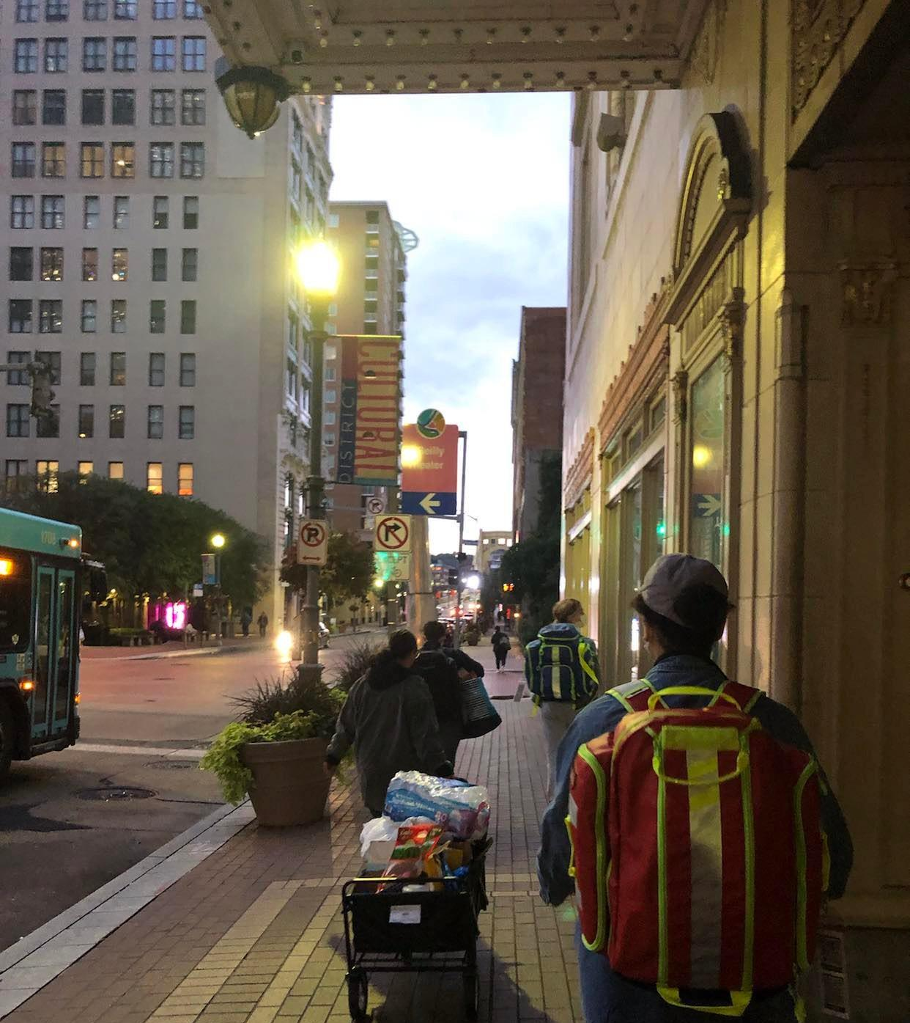

Street Medicine at Pitt
December 3, 2024 Event
Holiday Card Making!

Slide 2
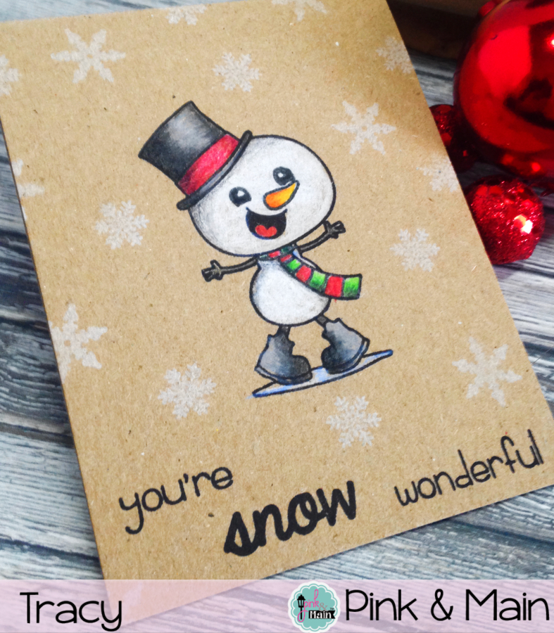
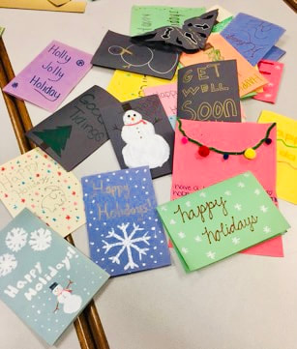
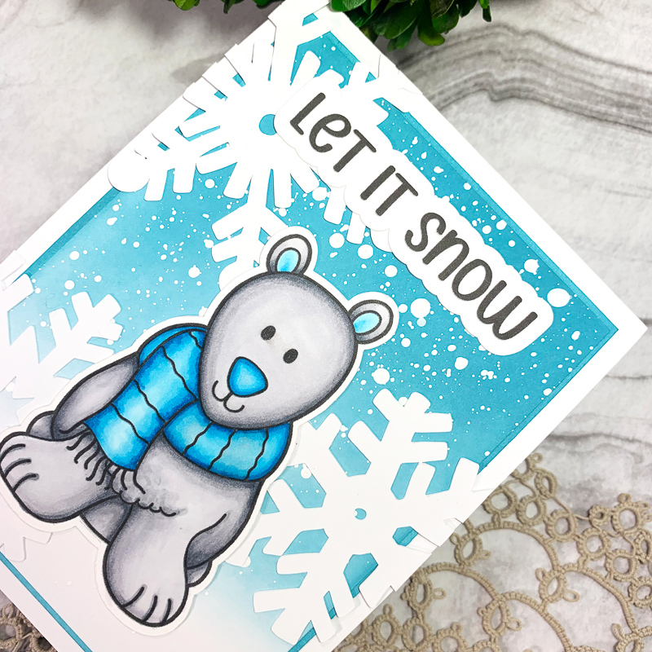
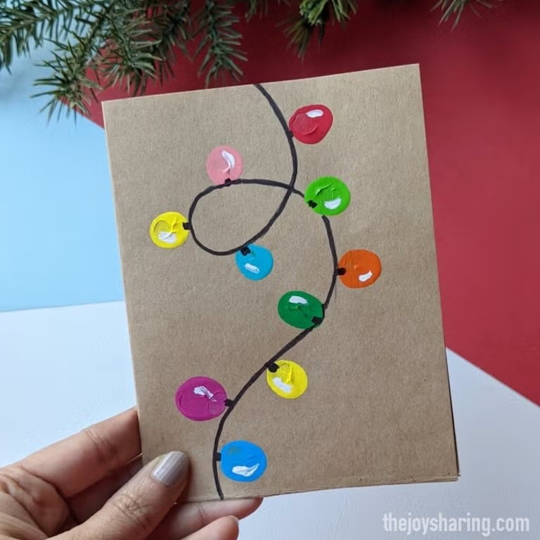
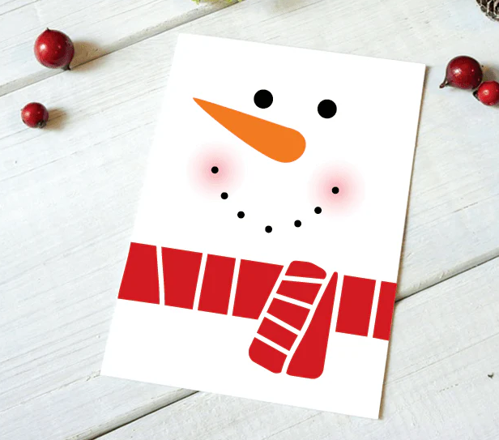
Keep it general! Don’t be specific about a particular holiday.
Sign cards with “Pitt Street Med.”
“Happy Holidays!”
“Wishing you well!”
“Be safe!”
“You are loved!”
“Season’s Greetings!”
“Sending you holiday cheer!”
“Sending you love during this holiday season!”

